Slide 1
The Biologist’s Guide to the Galaxy
-- NGS analysis using Galaxy
CCM Tutorial series
11.19.2019
Huayun Hou (Wilson Lab)
huayun.hou@sickkids.ca

Slide 2
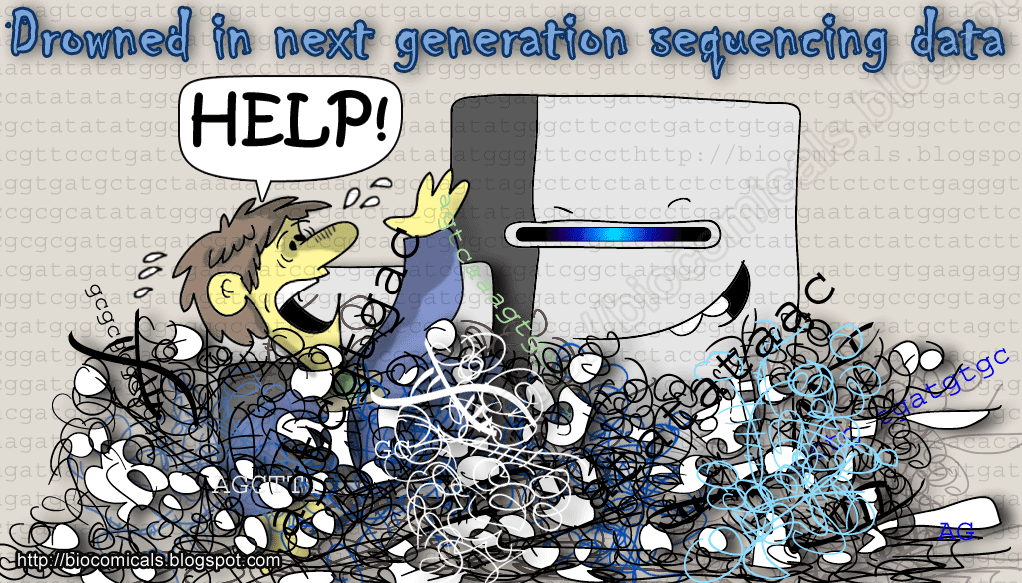

biocomicals.blogspot.com

Slide 3
Outline
Introduction to NGS data analysis
  QC, pre-processing, alignment, etc.
NGS analysis using Galaxy -- ChIP-seq as an example
  The Galaxy working environment
  History and datasets
  Execute tools
  Share and publish with Galaxy

Slide 4
NGS platforms enable a wide variety of methods
Genomics
Whole genome sequencing (WGS)
Exome sequencing (WES)
De novo sequencing
Targeted sequencing
…
Transcriptomics
RNA sequencing
  Total RNA, mRNA, small RNA, nascent RNA …
Mapping RNA interactions
  CLIP-seq …
Epigenomics
Methylation sequencing
ChIP-sequencing
Ribosomal profiling
…
Notes:
Whole- Genome Bisulfite Sequencing (WGBS) And Reduced Representation Bisulfite Sequencing (RRBS).

Slide 5

A general pipeline for NGS-data analysis
Preprocessing
Quality control
Raw reads
adaptor
Trimming and filtering
Alignment /
Assembly
Align to reference genome/transcriptome
De novo assembly
Application
specific
Analysis
ATCGGATC
ATCGGAAC
ATCGGATC
Gene A
Gene A
WT KO

Slide 6

Setting up your computing environment
Popular computing environments for bioinformatics tools
stand-alone Unix tools /R packages:
Pros:
Flexibility and reproducibility
Ability to process large numbers of samples in parallel
Larger user community
Cons:
Requires basic knowledge of programming
More dependent on your workstation
R/Bioconductor
Web-based
Unix tools

Slide 7
What is Galaxy
Galaxy is a free, open source, web-based platform for accessible, reproducible, and transparent computational biomedical research.
Tutorials: https://training.galaxyproject.org/training-material/
Notes:
Accessible: Users without programming experience can easily specify parameters and run tools and workflows.
Reproducible: Galaxy captures information so that any user can repeat and understand a complete computational analysis.
Transparent: Users share and publish analyses via the web and create Pages, interactive, web-based documents that describe a complete analysis.

Slide 8
Which Galaxy?
Galaxy home: http://galaxyproject.org/
Galaxy main public server: http://usegalaxy.org
Other public servers, cistrome for example: https://galaxyproject.org/use/cistrome-analysis-pipeline/
Local Galaxy instance: https://galaxyproject.org/admin/get-galaxy/
  Galaxy toolshed: https://toolshed.g2.bx.psu.edu/
Notes:
the Galaxy Team has enabled Galaxy to be instantiated on cloud computing infrastructures, primarily Amazon Elastic Compute Cloud (EC2)
Reasons for your own galaxy: customized selection of tools, process larger datasets, private data, develop tools for galaxy and develop galaxy itself.

Slide 9
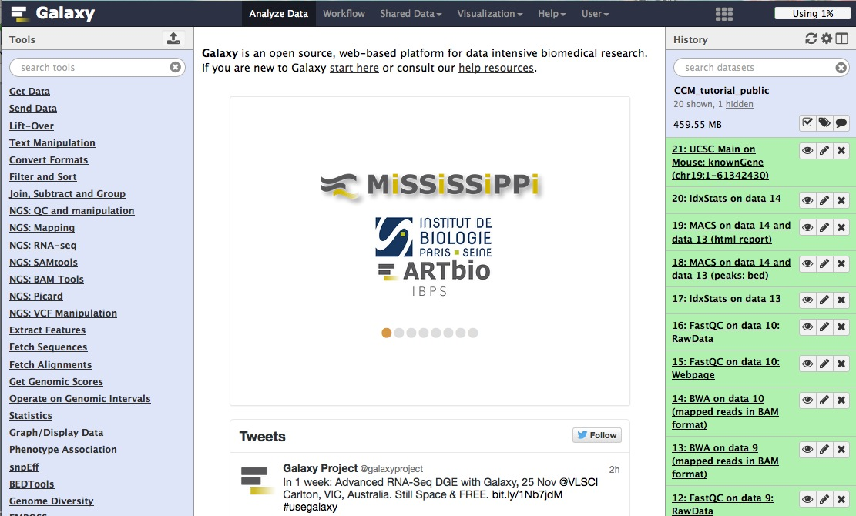
Galaxy main web interface
http://usegalaxy.org
Menu bar
Registering for an account greatly improves accessible features
Step-wise history of analysis and job status
List of analysis tools
Display analysis result, file content and other information
Notes:
Registration

Slide 10
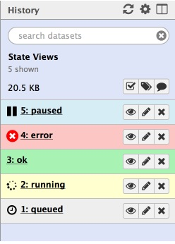
History
Current history:
  your working directory or workspace
  Job status
Multiple histories:
  Documentation of previous activities
  Share and publish
https://galaxyproject.org/tutorials/histories/
Notes:
Import history, show on galaxy.

Slide 11
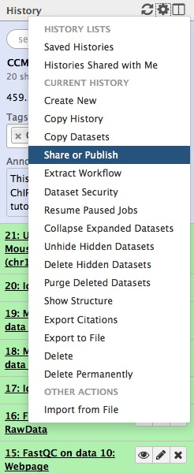
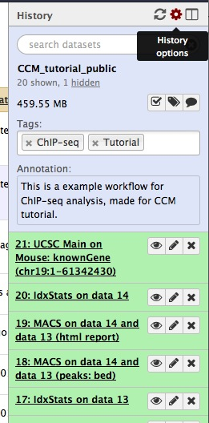
Manage histories
Tags and annotations
Steps and datasets

Slide 12
NGS tools in Galaxy
Importing data from multiple sources
QC and manipulation FASTQ reads
Mapping/Alignment
File formats conversions
Text manipulation
Genomic interval manipulation: intersect, join, group etc.
Basic statistical and plotting tools
Specific analysis: variants calling; genome assembly; RNA seq analysis; ChIP-seq and more

Slide 13
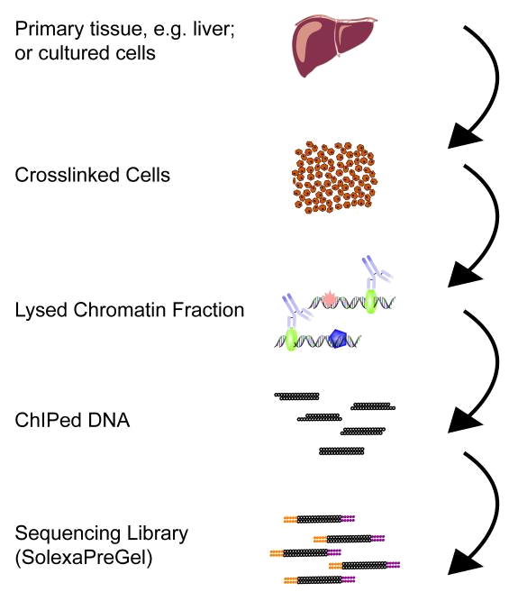
Experiment and analysis overview
Question: How does transcription factor A regulates gene expression
Experiment: Using ChIP-seq to profile the binding patterns of A in mouse liver
Get raw data
QC and trimming
Alignment
Visualization on genome browser
Peak (protein binding sites) calling
Functional interpretation of peaks
Save the workflow and repeat on different datasets
Data analysis

Slide 14
Tools
Steps
File formats
Experiment,
Public datasets
ChIP-seq
Input
Fastq
QC, filter, trimming
QC, filter, trimming
Fastqc, trimmomatic
Fastq
BWA, bowtie
Alignment
Alignment
Bam
Samtools
QC, filter
QC, filter
Bam
Bedtools,
genome browser
Visualization
Visualization
BedGraph/Bigwig
MACS2
Peak calling
Bed
Associated genes
Motif enrichment
Graphic representation
Overlapping

Slide 15
Importing data into Galaxy
Tools -> Get Data
  Upload File
    Local upload
    Link through URL
  GenomeSpace
  UCSC, BioMart and other online resources
Import History
  Saved or shared Galaxy session

Slide 16
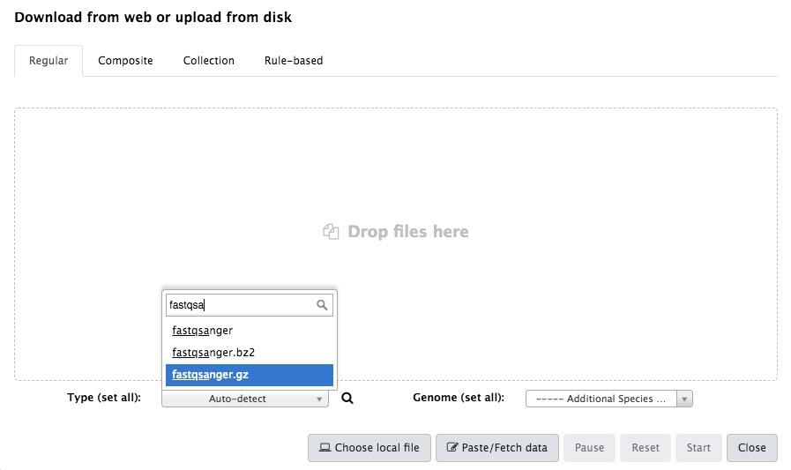
A collection is a list of files that can be processed together
Tutorial: https://galaxyproject.org/tutorials/collections/
For illumina sequencing reads, choose “fastqsanger”

Slide 17
Import history for this tutorial:
  Shared Data –histories
  Search user “huayun”
  Or https://usegalaxy.org/u/huayun/h/ccmtutorialpublic
  Import history

Slide 18
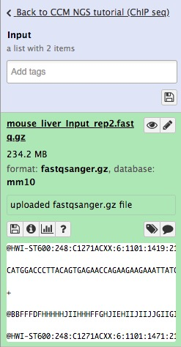
datasets
Collection
Edit attributes: name, datatype etc.
View dataset, or download binary files
Dataset
Detailed information on the command used to generate this dataste

Slide 19
Raw sequencing data
Fastq file format
  Text files encode both nucleotide as well as quality information
Example of a fastq file
@HWI-ST600:248:C1271ACXX:7:1101:1410:2127 1:N:0:TGACCA
TAATCGCTAAAATCAAAACGAAATGCTGCTTCTTACAGCAGCCTCCTTAG
+
B@@DDFFFGHHGHE@FIIGEHIFCHGIJIHIHHIEGIEHIIJIIHHIIIE
Line1: begin with @, sequence identifier
Line2: raw sequence letters
Line3: same information as line1
Line4: quality values for the sequence in line2

Slide 20
QC of the raw reads
Fastq files: 1) Mouse ChIP-seq of a transcription factor
2) The corresponding Input (genomic DNA)
FastQC : a quick evaluation of the quality of NGS data
  NGS: QC and manipulation -> FastQC
  http://www.bioinformatics.babraham.ac.uk/projects/fastqc/

Slide 21
Running fastqc (and other tools)
The tool
(Magical black box)
Parameters
Input files
Output files
Always read documentation of the tool first
Understand the format of input and output files
Understand what each parameter specifies
Galaxy helps:
  List input files of the correct format
  Keeping most parameters default (look for ”advance options”)

Slide 22
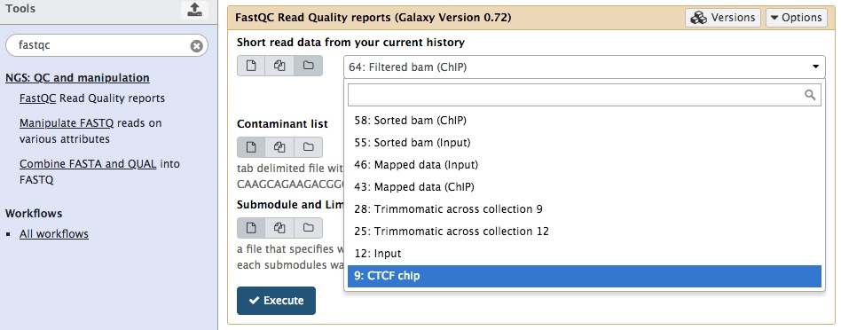
1. Look for the tool
2. Choose input file(s) and set parameters
3. Execute!

Slide 23
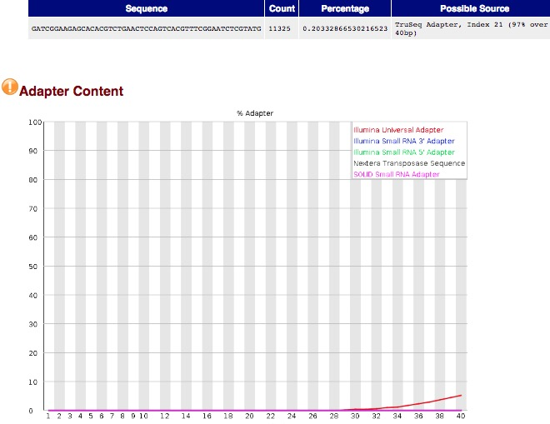
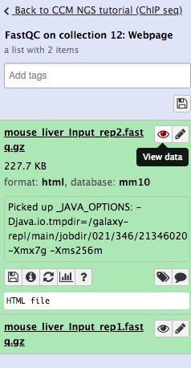
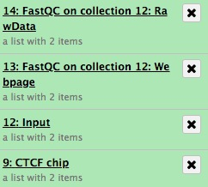
View results
History panel
Adapter at the end of some reads

Slide 24
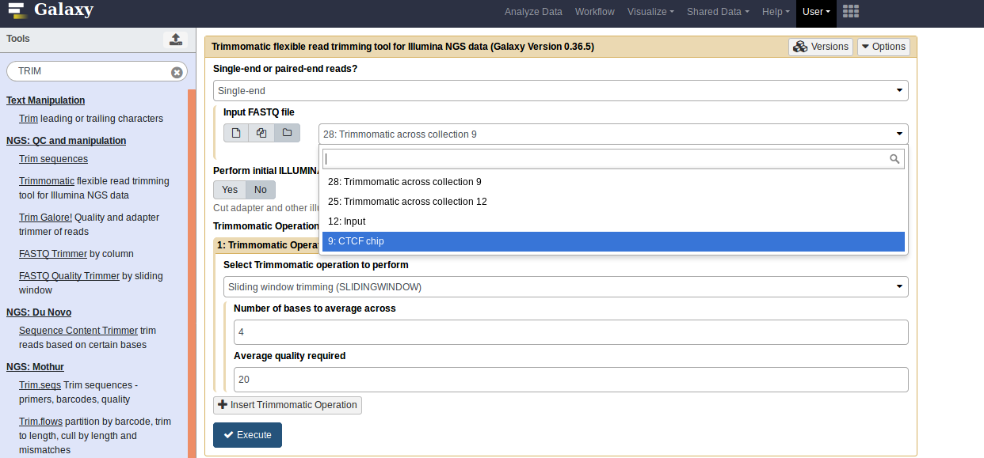
Trimming or filtering :
  Adapters, low quality reads, trim reads shorter
Choose input dataset

Slide 25
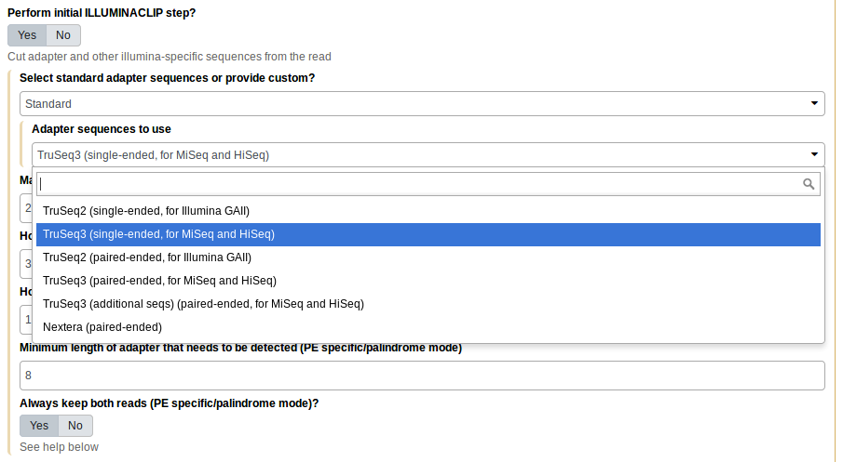
Choose adapter type

Slide 26
Alignment
Alignment tool: Choose according to your experiment
  Short DNA reads: BWA, Bowtie
  RNA seq: Splice-aware aligner such as STAR, HISAT; or pseudoalignment: Kallisto, Sailfish
Choose the correct genome assembly
  Usually requires a genome index
  Use built-in ones from Galaxy or customized ones
Alignment file format : SAM or BAM (binary version of SAM files; the most commonly used file format)
SAM file format: https://samtools.github.io/hts-specs/SAMv1.pdf
Use Samtools for manipulation

Slide 27
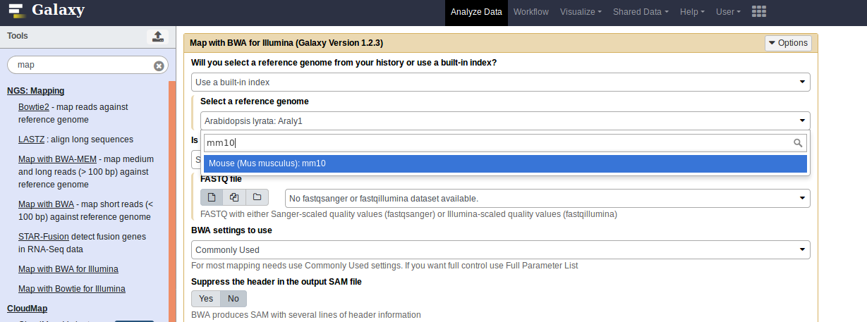

Slide 28
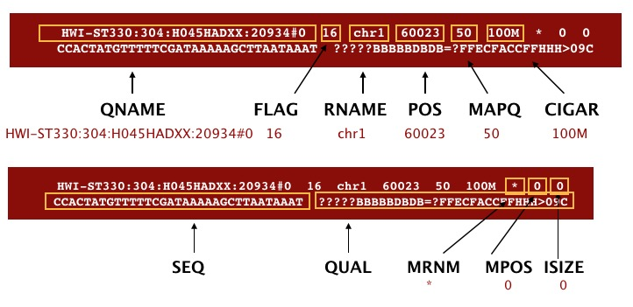

Slide 30
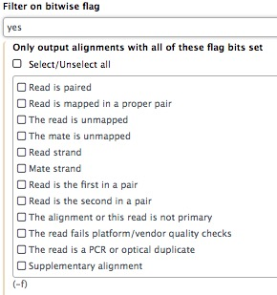
Post-processing
Common post-processing steps after alignment:
  Sort (by coordinates)
  Filter (by mapping quality or by bitwise flags)
  Filter against specific regions (i.e. remove mitochondrial reads, use “select regions”)

Slide 31
Quality control
Did the experiment work?
Correlation between samples: Deeptools:
  multiBamSummary
  PlotCorrelation (a correlation heatmap of samples)
Access library enrichment
  Deeptools: bamFingerprint
QC for RNAseq: RSeQC, and more

Slide 32
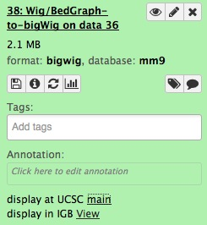
Visualization
Genome coverage file: bedGraph or Wiggle
  BEDtools: Creat a BedGraph of genome coverage
  BigWig: binary, quick accession
  Covert formats: Wig/bedGraph-to-bigWig
  Visualization on UCSC

Slide 33
Visualization
Another way to create bedGraph or BigWig files:
Deeptools: bamCoverage
  Similar as bedtools genomecoverage, calculates the coverage of reads across the genome
  Built in normalization functions
  Generate BigWig files directly (datasets 68, 71)

Slide 34
ChIP-seq overview
Sequence and align to genome
DNA binding protein

Slide 35
ChIP-seq: Peak Calling
Tools -> NGS: Peak Calling
  Tools for identifying ChIP-seq Peaks
  MACS2
    Accepts multiple TAG files (Bed, BAM, etc.)
      Multiple files (i.e. replicates) can be pooled to call peaks
    Control file to control for background
    Check genome size, tag size

Slide 36
Annotate the peaks
Overlap gene promoters?
  Fetch genes from UCSC : getData -> UCSC main; select bed file as output
  Get promoter regions
    Operate on Genomic Intervals --> Get flanks
  Overlap peaks and promoters
    BEDtools -> intersectBed -> choose parameter “-wo”

Slide 37
Other downstream analysis
Functional enrichment of peak associated genes:
  g-Profiler
Motif discovery, motif enrichment:
  MEME-suite
Visualization of ChIP-seq read distribution over peak regions:
  Deeptools

Slide 38
Workflow
Galaxy workflow is an abstract representation of a multi-steps analysis
A series of tools and the flow of datasets between them, without tied to any specific datasets
History options -> extract workflow

Slide 39
Summary
Galaxy: accessibility and reproducibility
Limitations:
  For process involving multiple steps and datasets, naming is not intuitive --- change names after you generate the datasets
  Restricted to tools available through the main portal or toolshed
Tips:
  Know your questions and design experiment properly
  Always read documentations for tools and know your data formats
  Follow published tutorials or workflows to begin
  Google is your friend!

Slide 40
So long, and thanks for all the attention!

