Slide 1
NGS data analysis
CCM Seminar series 11.26.2014
Michael Liang: m.liang@mail.utoronto.ca

Slide 2
Overview
Introduction to galaxy
Aligning raw NGS data in Galaxy
Peak calling with MACs
Basic operations with genomic intervals (peaks)
Viewing results in UCSC

Slide 3
Introduction to Galaxy
Galaxy is an open, web-based platform for accessible, reproducible, and transparent computational biomedical research.
Accessible: Users without programming experience can easily specify parameters and run tools and workflows.
Reproducible: Galaxy captures information so that any user can repeat and understand a complete computational analysis.
Transparent: Users share and publish analyses via the web and create Pages, interactive, web-based documents that describe a complete analysis.

Slide 4
Accessing Galaxy
Main portal: https://usegalaxy.org/
Wiki: https://wiki.galaxyproject.org/
Registering for an account greatly improves accessible features

Slide 5
Importing data into Galaxy
Tools -> Get Data
Upload File
Local upload
Link through URL
GenomeSpace
Other online resources
Import History
Saved or shared Galaxy session
http://wilsonlab.org/public/presentations/CCM_data/CEBPA.fastq.gz

Slide 6
History and Job status
QUEUED
RUNNING
COMPLETE
FAILED

Slide 7
Raw sequencing data
Fastq file format
Text files encode both nucleotide as well as ‘quality information’
Example of a fastq file
@HWI-ST600:248:C1271ACXX:7:1101:1410:2127 1:N:0:TGACCA
TAATCGCTAAAATCAAAACGAAATGCTGCTTCTTACAGCAGCCTCCTTAG
+
B@@DDFFFGHHGHE@FIIGEHIFCHGIJIHIHHIEGIEHIIJIIHHIIIE
@HWI-ST600:248:C1271ACXX:7:1101:1508:2105 1:N:0:TGACCA
GGTTGTCCACTCATAAGATGTGACCTGGCTCTTAGAGGAACTTTACAAAT
+
?@:?AABDFFFHDGEGGIIIAECHCHHHH@FHIEF*?F9FDBFH<DGIII
Line1: begin with @, sequence identifier
Line2: raw sequence letters
Line3: same information as line1
Line4: quality values for the sequence in line2

Slide 8
NGS: QC and FASTQ manipulation
Tools -> NGS TOOLBOX BETA -> NGS: QC and Manipulation
FASTQC: Perform basic quality checks on data
FASTQ GROOMER: “Groom” FASTQ file to correct version

Slide 9
NGS: MAPPING
Tools -> NGS TOOLBOX BETA -> NGS: Mapping
Utilities to map raw reads to reference genomes
BWA and Bowtie most commonly used
Input FASTQ -> Output SAM/BAM
NB: Make sure reference genomes are consistent! (hg19)

Slide 10
Alignment-output file
SAM(Sequence Alignment/Map format) file:
a tab-delimited text file that contains aligned sequence data information (human readable)
Each alignment line has 11 fields contain information such as mapping position, mapping quality, segment sequence...
Detailed description of SAM file format:
http://samtools.sourceforge.net/SAM1.pdf
NS500322:23:H0UM0AGXX:1:22305:20603:1636 0 chr1 93 0 61M * 0 0 CCCTGTAGTTAAAATTGACTAAGTATTGGAAGGGGCCTATAGACCTTGAGTATTCTCAAGG <AAAAFAFFF7FFFFFFFFF.FFFAFFFFFFFFFFFFFFF.F.F)FFFFFFFF<FAFFFFF XT:A:R NM:i:0 X0:i:2 X1:i:0 XM:i:0 XO:i:0 XG:i:0 MD:Z:61 XA:Z:chr7,-92852201,61M,0;
NS500322:23:H0UM0AGXX:1:13301:15368:13300 0 chr1 265 37 58M * 0 0 AGTTATTTATTGGCCCTTCAATTTTCATTTTTATAACCTACTATTACCTTGCAAAAAA 7AAAAFFFFFFFFFFFFFFFFFFFFFFFFFFFFF<<FFFFFFFFFFFFFFFFFFFFFF XT:A:U NM:i:0 X0:i:1 X1:i:0 XM:i:0 XO:i:0 XG:i:0 MD:Z:58

Slide 11
NGS: SAMTOOLS
Tools -> NGS TOOLBOX BETA -> NGS: SAM Tools
Suite of tools for processing SAM files
Capable of filtering based on quality, location, duplicates, etc.
Can convert to BAM format (used by most analysis tools)
SAM-to-BAM

Slide 12
NGS Workflow Recap

Slide 13
Extracting Workflow and sharing history
Steps involved in processing can be extracted as generic workflow
Workflows can be saved, modified, shared, etc.
History -> Options -> Extract Workflow
Full history including files and processing steps can be shared and loaded.
History -> Options -> Share or Publish

Slide 14
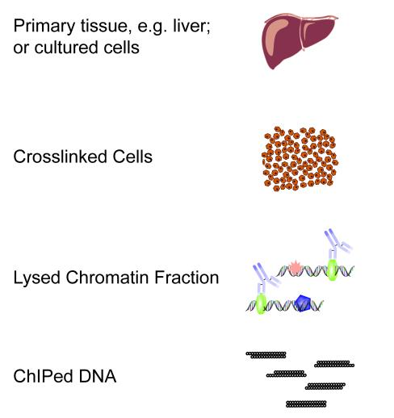
ChIP-seq overview
Sequence and align to genome

Slide 15
Alignment of ChIP-seq reads
DNA binding protein

Slide 16
Importing data into Galaxy: Shared Data
Access published datasets / histories
Shared Data -> Published Histories
Search for History name, ie. “ChIP-seq sample (2: post-alignment)”
Search for username, ie. “mimi31k”

Slide 17
NGS: Peak Calling
Tools -> NGS TOOLBOX BETA -> NGS: Peak Calling
Tools for identifying ChIP-seq Peaks
MACS
Accepts multiple TAG files (Bed, BAM, etc.)
Control File helps reduce technical artifacts
Check genome size, tag size

Slide 18
Downstream analyses
Tools -> NGS TOOLBOX BETA -> Bedtools
Tools for manipulating genomic intervals
Overlapping peaks for multiple factors
Intersect multiple sorted BED files
Filtering and sorting files
Select rows in a file based on “rules”
Find combinatorial binding versus singletons
Visualize in genome browser

Slide 19
Exporting data for other analyses
Download to local drive
Send to GenomeSpaces
Load from GenomeSpaces into other Galaxy servers

