Slide 1
The Biologist’s Guide to the Galaxy -- NGS analysis in Galaxy
CCM Tutorial series
11.18.2015
Huayun Hou
huayun.hou@sickkids.ca

Slide 2
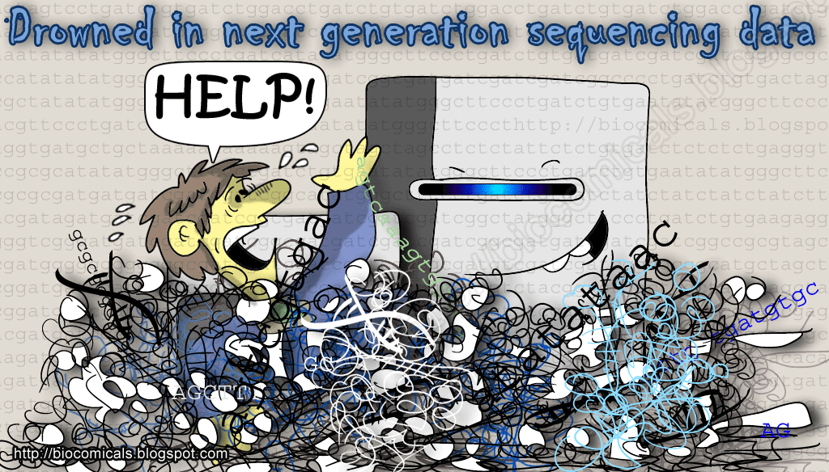
biocomicals.blogspot.com

Slide 3
Outline
What is Galaxy
NGS analysis on Galaxy
NGS analysis tools and pipelines
Text manipulation
Filtering, overlapping
Sharing and publish data with Galaxy
Workflow, history and pages

Slide 4
What is Galaxy
Galaxy is a free, open source, web-based platform for accessible, reproducible, and transparent computational biomedical research.
Wiki: https://wiki.galaxyproject.org/
Tutorials: https://wiki.galaxyproject.org/Learn
Notes:
Accessible: Users without programming experience can easily specify parameters and run tools and workflows.
Reproducible: Galaxy captures information so that any user can repeat and understand a complete computational analysis.
Transparent: Users share and publish analyses via the web and create Pages, interactive, web-based documents that describe a complete analysis.

Slide 5
Which Galaxy?
Galaxy home: http://galaxyproject.org/
Galaxy public server: http://usegalaxy.org
Galaxy on cloud: https://wiki.galaxyproject.org/CloudMan
Local Galaxy instance: https://wiki.galaxyproject.org/Admin/GetGalaxy
Galaxy toolshed: https://toolshed.g2.bx.psu.edu/
Notes:
the Galaxy Team has enabled Galaxy to be instantiated on cloud computing infrastructures, primarily Amazon Elastic Compute Cloud (EC2)
Reasons for your own galaxy: customized selection of tools, process larger datasets, private data, develop tools for galaxy and develop galaxy itself.

Slide 6
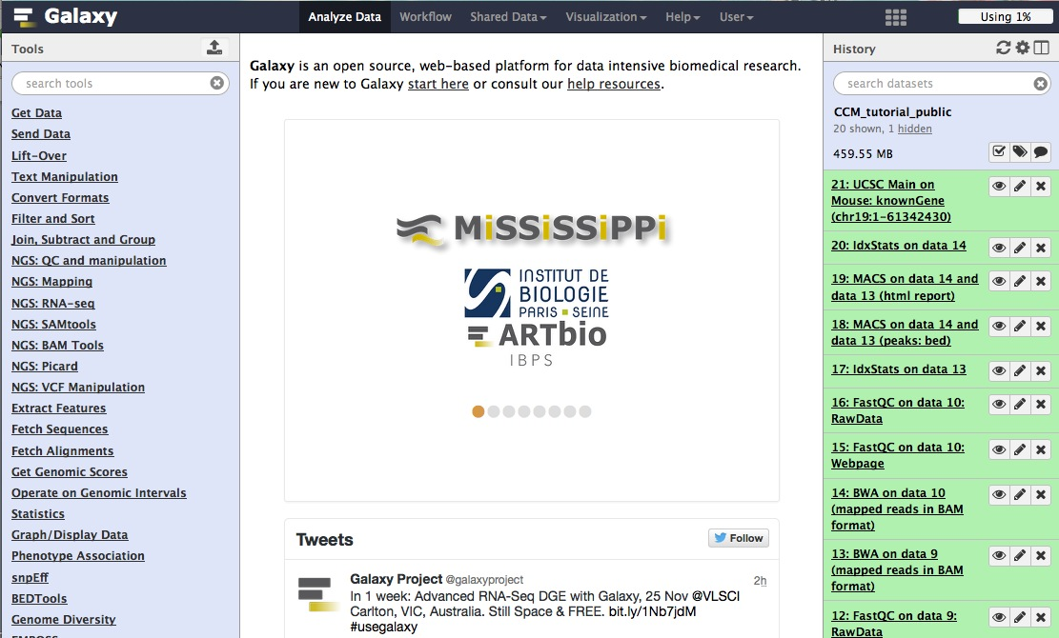
Galaxy main web interface
http://usegalaxy.org
Menu bar
Registering for an account greatly improves accessible features
List of analysis tools
Display analysis result, file content and other information
Step-wise history of analysis and job statues
Notes:
Registration

Slide 7
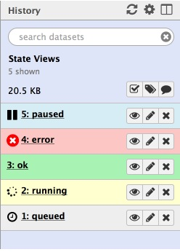
History
Current history:
your working directory or workspace
Job statues
Multiple histories:
Documentation of previous activities
Share and publish
History for this tutorial:
https://usegalaxy.org/u/huayun/h/ccmtutorialpublic
Shared Data – published histories
Notes:
Import history, show on galaxy.

Slide 8
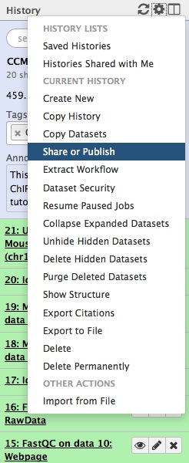
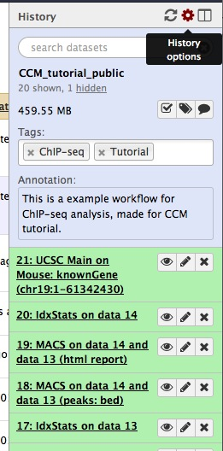
Manage histories
Tags and annotations
Steps and datasets

Slide 9
NGS tools in Galaxy
Importing data from multiple sources
QC and manipulation FASTQ reads
Mapping/Alignment
SAMTools and BamTools
Converting format
Genomic interval manipulation: intersect, join, group etc.
Analysis: SNP and INDEL analysis; RNA seq analysis; ChIP-seq

Slide 10
Analysis overview
Get data – raw data in FASTQ format
QC and trimming
Alignment – reads stored in bam format
Visualization – bedGraph or bigWig
Peak calling (for ChIP-seq) – bed format
Peak filtering and overlap with gene promoters

Slide 11
Importing data into Galaxy
Tools -> Get Data
Upload File
Local upload
Link through URL
GenomeSpace
UCSC, BioMart and other online resources
Import History
Saved or shared Galaxy session

Slide 12
QC and Trimming
FastQC : a quick impression on the quality of NGS data
NGS: QC and manipulation -> FastQC
http://www.bioinformatics.babraham.ac.uk/projects/fastqc/
FASTQ groomer : switch between quality score systems
Be careful with versions
Trimming or filtering :
Adaptors, low quality reads, trim reads shorter
Filter FASTQ (sliding window), Clip (adaptor) etc.

Slide 13
Alignment
Aligners: Bowtie2 (short reads); Bwa (short reads); Bwa-mem (longer reads ( > 100bp))
Choose genome assembly
Output format: bam file (binary version of sam files)
Summary of alignment: Samtools -> idxStats and flagStat
Filter bam reads : Bamtools -> filter -> MapQuality (>, =, < etc.)

Slide 14
Visualization
Genome coverage file: bedGraph or Wiggle
BEDtools: Creat a BedGraph of genome coverage
BigWig: binary, quick accession
Covert formats: Wig/bedGraph-to-bigWig
Visualization on UCSC

Slide 15
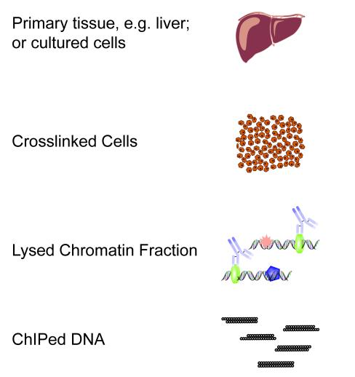
ChIP-seq: Peak Calling
Sequence and align to genome
DNA binding protein

Slide 16
ChIP-seq: Peak Calling
Tools -> NGS TOOLBOX BETA -> NGS: Peak Calling
Tools for identifying ChIP-seq Peaks
MACS
Accepts multiple TAG files (Bed, BAM, etc.)
Control File helps reduce technical artifacts
Check genome size, tag size

Slide 17
Annotate the peaks
Overlap gene promoters?
Fetch genes from UCSC : getData -> UCSC main; select bed file as output
Overlap: Operate on Genomic Intervals -> join

Slide 18
Workflow
Galaxy workflow is an abstract representation of a multi-steps analysis
A series of tools and the flow of datasets between them, without tied to any specific datasets
History options -> extract workflow

Slide 19
Summary
Galaxy: accessibility and reproducibility
Limitations:
For process involving multiple steps and datasets, naming is not intuitive
Restricted to tools available through the main portal or toolshed
Tips:
Always read tool descriptions
Follow published tutorials or workflows first
Google is your friend!

Slide 20
So long, and thanks for all the attention!

