Slide 1
Introduction to NGS data
Nov 19th 2014
CCM workshop
Huayun Hou
huayunhou@gmail.com
Wilson Lab

Slide 2
Applications of NGS
DNA-Seq
de-novo genome assembly
Finding genetic polymorphisms (SNPs, CNVs etc. )
RNA-Seq
Identifying transcribed regions
Transcriptome profiling
ChIP-Seq
Identifying protein binding regions in the genome (Transcription factors; histone modifications etc. )
Others
DNA methylation profiles
Metagenomics

Slide 4
Table of content
Data formats and handling
Quality control
Data sources
Online tools and platforms
UCSC genome browser (http://genome.ucsc.edu/)
WashU epigenome browser (http://epigenomegateway.wustl.edu/browser/)
Cistrome (http://cistrome.org/Cistrome/Cistrome_Project.html)
Galaxy (usegalaxy.org)
There’s no single solution to NGS data analysis
Each type of data / experiment requires fine tuning of its workflow
But there are common principles
Google is your friend!

Slide 5
NGS data analysis pipeline
Genomic DNA
cDNA (RNAseq)
Library preparation
Quality control
Raw sequencing reads
Quality control
Publicly available datasets
Sequence alignment
Peak calling
(ChIP-seq)
Count table
(RNA seq)
Genomic annotation
Brower visualization
Motif discovery
Differential analysis
Functional enrichment analysis

Slide 6
Raw sequencing data
Fastq file format
Text files encode both nucleotide as well as ‘quality information’
Example of a fastq file
@HWI-ST600:248:C1271ACXX:7:1101:1410:2127 1:N:0:TGACCA
TAATCGCTAAAATCAAAACGAAATGCTGCTTCTTACAGCAGCCTCCTTAG
+
B@@DDFFFGHHGHE@FIIGEHIFCHGIJIHIHHIEGIEHIIJIIHHIIIE
@HWI-ST600:248:C1271ACXX:7:1101:1508:2105 1:N:0:TGACCA
GGTTGTCCACTCATAAGATGTGACCTGGCTCTTAGAGGAACTTTACAAAT
+
?@:?AABDFFFHDGEGGIIIAECHCHHHH@FHIEF*?F9FDBFH<DGIII
Line1: begin with @, sequence identifier
Line2: raw sequence letters
Line3: same information as line1
Line4: quality values for the sequence in line2

Slide 7
Illumina quality scores
B@@DDFFFGHHGHE@FIIGEHIFCHGIJIHIHHIEGIEHIIJIIHHIIIE
A string of same length as the sequence: one score for each nucleotide
Quality scores represented as ASCII characters
(http://en.wikipedia.org/wiki/ASCII)
Phred quality score + 64
Phred quality score is calculated by base calling software
Phred = -10 * log₁₀ E ( E = error rate)
Phred = 10 → 10% error rate → 90% confidence
e.g. Phred = 10; quality score = 10 + 64 = 74; ASCII character 74 = J
Why sequencing quality matters?
Bad reads or mutation?
High gene expression or PCR duplications?
Sensible quality assessment is needed

Slide 8
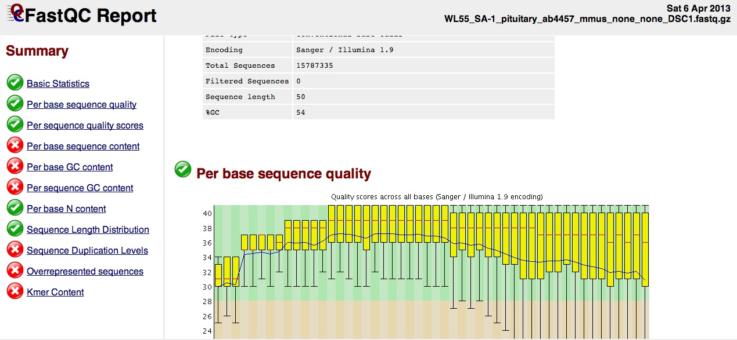
Interpreting QC
FastQC :A quality control tool for high throughput sequence data. (http://www.bioinformatics.babraham.ac.uk/projects/fastqc/)
Notes:
General quality control check on the sequence files, help indicate if there were any major technical issues.
8

Slide 9
Sequence alignment
Basic aim of genomics studies :
What are the elements in the sample?
How abundant are the elements in the sample?
Purpose: To relate sequencing reads to existing knowledge
Existing knowledge: reference genome; gene structures etc.
A common technique for mapping reads to features is alignment
Multiple alignmers

Slide 10
Alignment of ChIP-seq reads
Mapping to the whole genome
Be aware of multiple mapping reads and duplicated reads
DNA binding protein

Slide 11
Alignment of RNA-seq reads
Align to know transcriptome will miss unknown transcribed regions
Alternative splicing
Inclusion of introns
TopHat and Cufflinks
http://www.engr.uconn.edu/~ywu/Courses/CSE5095S12/rnaseq-paperpresentation.pdf

Slide 12
Alignment-output file
SAM(Sequence Alignment/Map format) file:
a tab-delimited text file that contains aligned sequence data information (human readable)
Each alignment line has 11 fields contain information such as mapping position, mapping quality, segment sequence...
Detailed description of SAM file format:
http://samtools.sourceforge.net/SAM1.pdf
NS500322:23:H0UM0AGXX:1:22305:20603:1636 0 chr1 93 0 61M * 0 0 CCCTGTAGTTAAAATTGACTAAGTATTGGAAGGGGCCTATAGACCTTGAGTATTCTCAAGG <AAAAFAFFF7FFFFFFFFF.FFFAFFFFFFFFFFFFFFF.F.F)FFFFFFFF<FAFFFFF XT:A:R NM:i:0 X0:i:2 X1:i:0 XM:i:0 XO:i:0 XG:i:0 MD:Z:61 XA:Z:chr7,-92852201,61M,0;
NS500322:23:H0UM0AGXX:1:13301:15368:13300 0 chr1 265 37 58M * 0 0 AGTTATTTATTGGCCCTTCAATTTTCATTTTTATAACCTACTATTACCTTGCAAAAAA 7AAAAFFFFFFFFFFFFFFFFFFFFFFFFFFFFF<<FFFFFFFFFFFFFFFFFFFFFF XT:A:U NM:i:0 X0:i:1 X1:i:0 XM:i:0 XO:i:0 XG:i:0 MD:Z:58

Slide 13
Alignment output file
SAM(Sequence Alignment/Map format) file
BAM file:
Compressed binary version of SAM file (NOT human readable)
Can be visualized after converting to SAM file
galaxy BAM-to-SAM function
Samtools (command line)
.bai file: index file for the corresponding bam file
Flag:
Can be used to filter reads
Mapping quality score
Read identifier
Aligned position
CIGAR
NS500322:23:H0UM0AGXX:1:22305:20603:1636 0 chr1 93 0 61M * 0 0 CCCTGTAGTTAAAATTGACTAAGTATTGGAAGGGGCCTATAGACCTTGAGTATTCTCAAGG <AAAAFAFFF7FFFFFFFFF.FFFAFFFFFFFFFFFFFFF.F.F)FFFFFFFF<FAFFFFF XT:A:R NM:i:0 X0:i:2 X1:i:0 XM:i:0 XO:i:0 XG:i:0 MD:Z:61 XA:Z:chr7,-92852201,61M,0;
NS500322:23:H0UM0AGXX:1:13301:15368:13300 0 chr1 265 37 5M2I1D51M * 0 0 AGTTATTTATTGGCCCTTCAATTTTCATTTTTATAACCTACTATTACCTTGCAAAAAA 7AAAAFFFFFFFFFFFFFFFFFFFFFFFFFFFFF<<FFFFFFFFFFFFFFFFFFFFFF XT:A:U NM:i:0 X0:i:1 X1:i:0 XM:i:0 XO:i:0 XG:i:0 MD:Z:58
Notes:
This file acts like an external table of contents, and allows programs to jump directly to specific parts of the bam file without reading through all of the sequences.

Slide 14
BED(Browser Extensible Data) file:
A tab-delimited text file describes genomic intervals (reads, peaks, genes, etc)
0-based
Essential columns : chromosome – start – stop
Specific descriptions of file formats: https://genome.ucsc.edu/FAQ/FAQformat.html
bed format file of aligned sequencing reads :
Chromosome start End Name Score Strand
chr1 92 153 NS500322:23:H0UM0AGXX:1:22305:20603:1636 0 +
chr1 205 264 NS500322:23:H0UM0AGXX:3:22506:4037:7916 23 +
Read identifier
Alignment score
bed format file of TF binding sites (peaks) :
Chromosome start End Name Score
Chr1 3006970 3007100 chip_TF1_1 120
chr1 3015000 3015120 chip_TF1_2 100
Chr1 4007004 4007145 chip_TF1_3 5
Peak identifier
Peak significance score

Slide 15
BedGraph/Wiggle file format:
Used to represent quantitative information across genomic regions.
e.g. read depth from ChIP-seq experiments.
chr1 3000095 3000131 1
chr1 3003970 3004006 2
chr1 3006970 3007004 2
chr1 3007004 3007006 4
chr1 3007006 3007040 2
Visualization using genome browser
bigWig file format (most widely used for data visualization)
indexed binary format
only the portions of the files needed to display a particular region are transferred

Slide 16
File formats recap
Fastq : raw sequencing reads (sequences and sequencing qualities)
Sam : aligned reads (sequence, aligned position, alignment score etc.)
Bam : binary version of sam files (widely used for analysis because of smaller size and quicker accession)
Bed : tab delimitated files representing genomic regions ( could be used to describe reads, peaks, gene structures etc. )
Bedgraph/wiggle : read density across genomic positions (used for visualization)
Bigwig: binary version of wiggle files (allow quick access of large data files)

Slide 17
Where to find NGS data?
Public data repositories
Gene expression omnibus (GEO) : public functional genomics data repository; array and sequencing data
ArrayExpress : Functional genomics experiments; mirrors GEO database
Genomics consortia
ENCODE, the encyclopedia of DNA elements
http://www.genome.gov/encode/
FANTOM5, functional annotation of the mammalian genome
Used CAGE to fine map transcription start sites in a large number cell lines and primary tissues in human and mouse
http://fantom.gsc.riken.jp/5/
NIH epigenomics roadmap
Human epigenomics datasets, including DNA methylation, histone modifications, chromatin accessibility etc. in ES cells and tissues
http://www.roadmapepigenomics.org/

Slide 18
Navigating UCSC genome browser for data and visualization
Genome Browser
graphical view of genes, gene structure, and annotation tracks.
Public available data including ENCODE and FANTOM5
Custom Tracks
displaying your data in conjunction with existing browser data.
Table Browser
bulk data manipulation and downloads, intersections and joins between data sets.
Session
sharing your data with others.
Useful tutorial： http://www.openhelix.com/ucsc
UCSC genome browser tutorial Zweig AS et. al 2008

Slide 19
Visualization in UCSC
Annotation tracks :
Genes, SNPs, conservation, repeats etc.
Genomic tracks:
Microarray probes, ChIP-seq, RNA-seq etc.
Custom tracks:
Upload your own files (http://genome.ucsc.edu/goldenPath/help/customTrack.html#format)
Display mode:
Hide
Dense: all features are collapsed in one line
Full: features are fully displayed
Pack
Configurations:
Data value range; track height; smoothing etc.
https://genome.ucsc.edu/goldenPath/help/hgWiggleTrackHelp.html

Slide 20
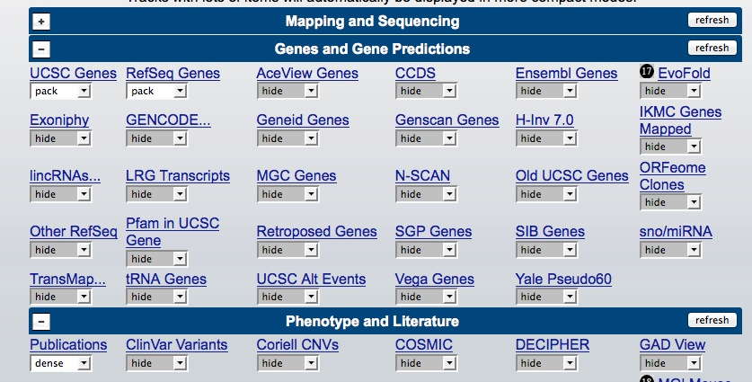
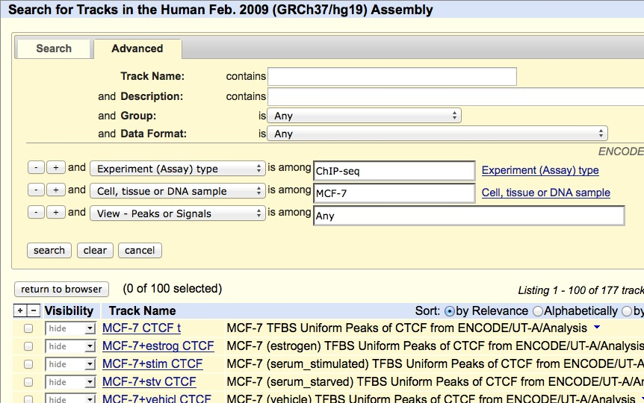
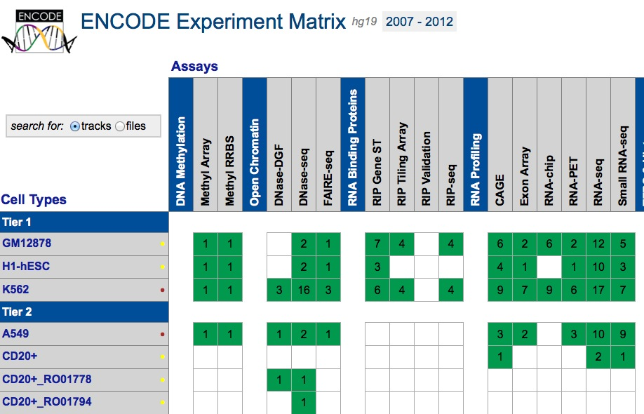
Explore data
Choose from what’s available
Track control panel
Search for what’s available
Track search
ENCODE at UCSC (http://genome.ucsc.edu/ENCODE/)

Slide 21
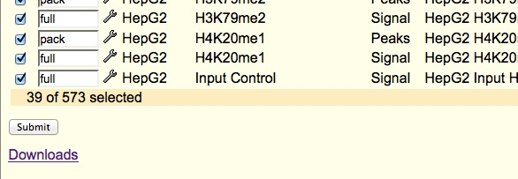
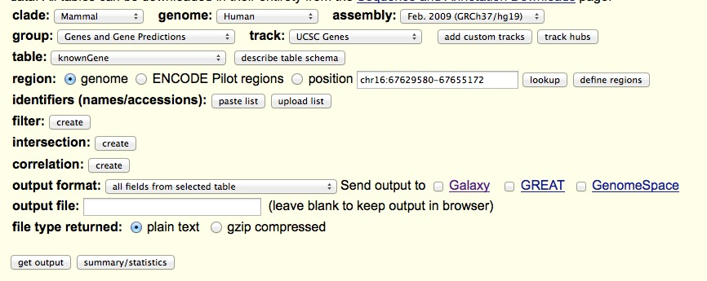
Download data
“Downloads” button in track hubs
Good for downloading a few files individually
Download menu
Genome assembly fies
Table browser (tools – table browser)
Good for downloading genome annotation files
Can filter/select fields of output
Can be exported to galaxy
UCSC ftp
(ftp://hgdownload.soe.ucsc.edu/goldenPath/)
Download large numbers of datasets
Help (https://genome.ucsc.edu/goldenPath/help/ftp.html)

Slide 22
WashU epigenome browser
http://epigenomegateway.wustl.edu/browser/
Public track hubs:
A Hub has to be load first for tracks within that data hub to be loaded
Encode, epigenome roadmap project, long-range chromatin interactions
Nice display of long-range interaction data
Custom tracks: have to be in specific format

Slide 23
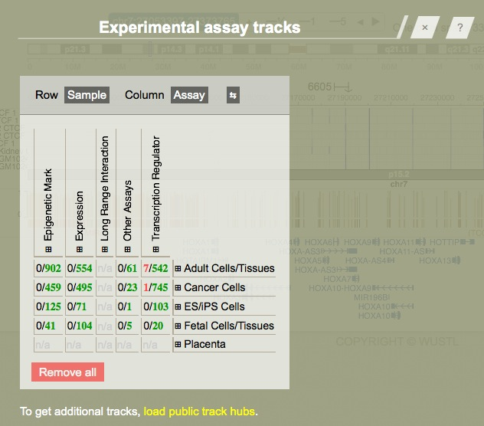
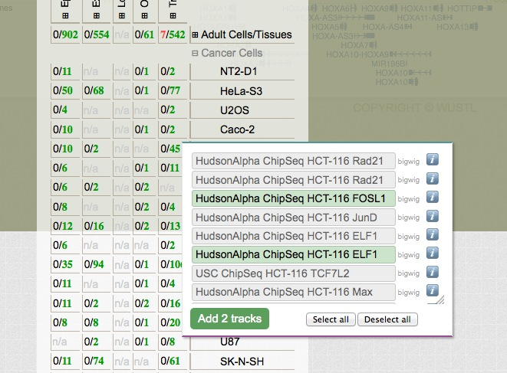
Search tracks with key words.
Choose from track table
Add selected tracks

Slide 24
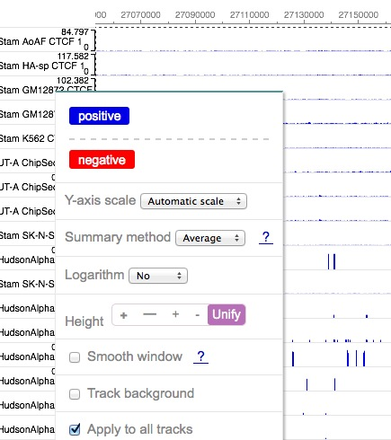
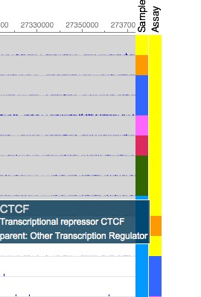
Track configuration: right click on the track
Tracks can be grouped base on sample(cell line or tissues) or assay type and each subtype of tracks can be configured separately
Right click to configure the subtype of tracks
All tracks will be modified accordingly

